Slide 1
Apache Kafka
Insights & Data - BigData

Slide 2

Kafka Introduction

Slide 3
Kafka Introduction
Apache Kafka is an open source stream processing platform developed by the Apache software foundation written in Scala and java.
Apache Kafka was originally developed by LinkedIn.
Apache Kafka is a distributed publish-subscribe messaging system and a robust queue that can handle a high volume of data and enables you to pass messages from one end-point to another.
Kafka is built on top of the ZooKeeper synchronization service
It integrates very well with Apache Storm and Spark for real-time streaming data analysis.

Slide 4
Kafka Introduction
In the Publish-Subscribe system, message producers are called publishers and message consumers are called subscribers
Kafka is suitable for both offline and online message consumption. Kafka messages are persisted on the disk and replicated within the cluster to prevent data loss.
Point to Point Messaging System
Publish-Subscribe Messaging System

Slide 5
Why Kafka ?
Client
Source
Data Pipelines Start like this.

Slide 6
Why Kafka ?
Client
Source
Client
Client
We can then reuse them
Client

Slide 7
Why Kafka ?
Client
Data Pipelines
Backend
Client
Another Backend
Client
We can also add additional endpoints to the existing sources for given data pipelines
Client

Slide 8
Why Kafka ?
Client
Backend
Client
Another Backend
Client
Another Backend
Client
Another Backend
Pipelines start to look like this

Slide 9
Why Kafka ?
Client
Backend
With maybe some
of this
Client
Another Backend
Client
Another Backend
Client
Another Backend
As distributed systems and services increasingly become part of a modern architecture, this makes for a fragile system

Slide 10
Why Kafka ?
Producers
Source System
Source System
Source System
Source System
Brokers
Kafka
Consumers
Hadoop
Security Systems
Real-time monitoring
Data Warehouse
Kafka decouples Data Pipelines

Slide 11
Key Terminologies
Kafka maintains feeds of messages in categories called topics.
Processes that publish messages to a Kafka topic are called producers.
Processes that subscribe to topics and process the feed of published messages are called consumers.
Kafka is run as a cluster comprised of one or more servers each of which is called a broker.
Communication between all components is done via a high performance simple binary API over TCP protocol

Slide 12
Architecture
Producer
Producer
Producers
Kafka Cluster
Broker
Broker
Broker
Broker
Zookeeper
Consumers
Offsets
Consumer
Consumer

Slide 13
Topics - Partitions
Topics are broken up into ordered commit logs called partitions.
Each message in a partition is assigned a sequential id called an offset.
Data is retained for a configurable period of time*
Partition 1
0
1
2
3
4
5
6
7
8
9
10
11
12
13
Partition 2
0
1
2
3
4
5
6
7
8
9
10
11
Writes
Partition 3
0
1
2
3
4
5
6
7
8
9
10
11
12
13
Old
New

Slide 14
Message Ordering and Guarantees
Message Ordering
Ordering is only guaranteed within a partition for a topic
To ensure ordering:
Group messages in a partition by key (producer)
Configure exactly one consumer instance per partition within a consumer group
Guarantees
Messages sent by a producer to a particular topic partition will be appended in the order they are sent
A consumer instance sees messages in the order they are stored in the log
For a topic with replication factor N, Kafka can tolerate up to N-1 server failures without “losing” any messages committed to the log

Slide 15
What is pub sub ?
Producer
publish(topic, msg)
Consumer
subscribe
Topic 1
Topic 2
msg
Topic 3
Publish subscribe
system
Consumer
Producer
msg
Notes:
Multiple subscribers, decoupling
Some examples : email notification on adding connection etc

Slide 16
Producer
Producers publish to a topic of their choosing (push)
Load can be distributed
Typically by “round-robin”
Can also do “semantic partitioning” based on a key in the message
Brokers load balance by partition
Can support async (less durable) sending
All nodes can answer metadata requests about:
Which servers are alive
Where leaders are for the partitions of a topic

Slide 17
Producer – Load Balancing and ISRs
Producer
Partition:
Leader:
ISR:
0
100
101,102
Partition:
Leader:
ISR:
1
101
100,102
0
0
0
1
1
1
Partition:
Leader:
ISR:
2
102
101,100
2
2
2
Broker 100
Broker 101
Broker 102

Slide 18
Consumer
Multiple Consumers can read from the same topic
Each Consumer is responsible for managing it’s own offset
Messages stay on Kafka…they are not removed after they are consumed. Consumer can come and go back.
1234567
Fetch
Consumer
1234568
1234569
1234570
Producer
1234571
Fetch
Consumer
1234572
1234573
1234574
Fetch
1234575
Consumer
Send
1234576
1234577
1234577
Write

Slide 19
Consumer - Groups
Consumers can be organized into Consumer Groups
Common Patterns:
1) All consumer instances in one group
Acts like a traditional queue with load balancing
2) All consumer instances in different groups
All messages are broadcast to all consumer instances
3) “Logical Subscriber” – Many consumer instances in a group
Consumers are added for scalability and fault tolerance
Each consumer instance reads from one or more partitions for a topic
There cannot be more consumer instances than partitions

Slide 20
Consumer - Groups
Kafka Cluster
Broker 1
Broker 2
P0
P3
P1
P2
Consumer Groups provide isolation to topics and partitions
C1
C2
C3
C4
C5
C6
Consumer Group A
Consumer Group B

Slide 21
Consumer - Groups
Kafka Cluster
Broker 1
Broker 2
P0
P3
P1
P2
Can rebalance themselves
X
C1
C2
C3
C4
C5
C6
Consumer Group A
Consumer Group B

Slide 22
Automatic load balancing
Producer
Producer
Broker
Broker
Consumer
Consumer

Slide 23
Why is Kafka so fast?
Fast writes:
While Kafka persists all data to disk, essentially all writes go to the page cache of OS, i.e. RAM.
Fast reads:
Very efficient to transfer data from page cache to a network socket
Linux: sendfile() system call
Combination of the two = fast Kafka!

Slide 24
Kafka Features
Features
High throughput to support high volume event feeds.
Support real-time processing of these feeds to create new, derived feeds.
Support large data backlogs to handle periodic ingestion from offline systems.
Guarantee fault-tolerance in the presence of machine failures.

Slide 25
use cases for Apache Kafka
Messaging
Website Activity Tracking
Metrics
Log Aggregation
Stream Processing
Event Sourcing
Commit Log

Slide 26
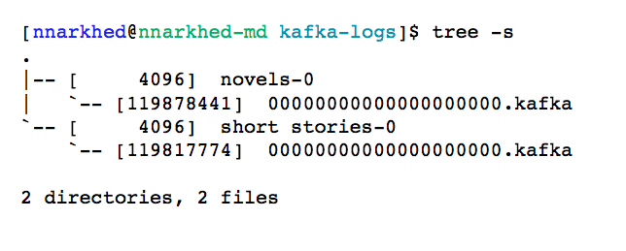
Efficiency #1: simple storage
Each topic has an ever-growing log
A log == a list of files
A message is addressed by a log offset
Notes:
One topic is enough

Slide 27
Efficiency #2: careful transfer
Batch send and receive
No message caching in JVM
Rely on file system buffering
Zero-copy transfer: file -> socket

Slide 28
Performance
2 Linux boxes
16 2.0 GHz cores
6 7200 rpm SATA drive RAID 10
24GB memory
1Gb network link
200 byte messages
Producer batch size 200 messages

Slide 29
Basic performance metrics
Producer batch size = 40K
Consumer batch size = 1MB
100 topics, broker flush interval = 100K
Producer throughput = 90 MB/sec
Consumer throughput = 60 MB/sec
Consumer latency = 220 ms
Notes:
s

Slide 30
Latency vs throughput
(100 topics, 1 producer, 1 broker)

Slide 31
Scalability
(10 topics, broker flush interval 100K)

Slide 32
Throughput vs Unconsumed data
Notes:
Add compression line here instead

Slide 33
LinkedIn Kafka Statistics
8000+ Topics
140,000+ Partitions
278B messages/day
4.4 M messages/second
49 TB+ / day incoming
176 TB+ / day outgoing

Slide 34

Apache Storm with Apache Kafka
Apache Storm With Apache Kafka

Slide 35
Background
Digital Advertising
Website banner, pre-roll video, free mobile app
Buy ad impressions at ‘real-time’
Response within 50ms for auction
Find best match between people and ads
Show ad that you care about
Use machine learning algo to ‘learn’
Data, data, data

Slide 36
Use case
10+ billion daily impressions
30,000+ new sites daily
How many daily impressions by site?
How are the impressions distributed?
Country, Province, Gender, Age Range, etc...

Slide 37
High-level System Architecture
10+ billion daily bid requests
Make up to 4 billion daily bids
Serve millions of daily impressions
10+ TB of messages daily
300k+ message / second
Bidder
Adserver
Kafka
Storm
Hbase/Hadoop

Slide 38
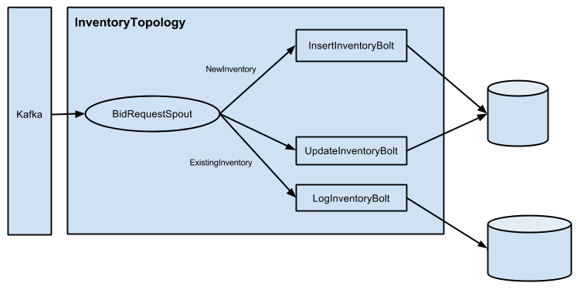
Storm - Topology
Spout read each BidRequest from Kafka topic
Determine new or existing, emit tuples to different “streams”

Slide 39
Storm - Topology
InsertInventoryBolt
Process tuples from NewInventory stream
Field grouping on source ID, domainName
Tick tuple every 1 second
UpdateInventoryBolt
Process tuples from ExistingInventory stream
Field grouping on inventoryId
Tick tuple every 1 second

Slide 40
Storm - Topology
LogInventoryBolt
Process tuples from ExistingInventory stream
Field grouping on inventoryId
Tick tuple every 10 seconds

